Slide 1
Cybercrime and Threats

Slide 2

HELLO!

Slide 3
Cyber Crime
1
Let’s start with the first set of slides

Slide 4
Cyber crimes are, as the name implies, crimes committed using computers, phones or the internet.

Slide 5
Some types of cyber crime include:
Illegal interception of data.
System interferences.
Copyrights infringements.
Sale of illegal items.

Slide 6
Classification of Cyber Crime
It can be classified into four major categories as:
Cyber crime against individual
Cyber crime against property
Cyber crime against organization
Cyber crime against society

Slide 7
1. Against Individual
Email spoofing: It is one in which email header is forget so that pass to originate one source but actually sent another source.
Spamming: it means send multiple copies of unsolicited mails.
Cyber Defamation: it occur when defamation take place with the help of computers or internet.
Harassment and Cyber stalking: it means following moves of an individual’s activity over the internet.

Slide 8
2. Against Property
Credit Card Fraud
Intellectual Property crimes: Software piracy, Copyright Infringement, Trademark Violation, Theft of computer source code.
Inter time theft: it usage internet hours by unauthorized person which actually paid by another person.

Slide 9
3.Against Organization
Unauthorized accessing of computer
Denial of services
Virus attack
Logic bomb
Trojan Horse
Email bombing
Data Diddling

Slide 10
4. Against Society
Forgery: Currency notes, Marks-sheets and stamps etc can be forged by computer and scanner or printer.
Cyber Terrorism: It is the use of the Internet to conduct violent acts that result in, or threaten, the loss of life, in order to achieve political or ideological gains through threat.
Web jacking: Hacker gain access or control over a website.

Slide 11
Cyber Threats
2

Slide 12
Cyber Threats
A Cyber threat is any malicious act that attempts to gain access to a computer network without authorization or permission from the owners.
It refers to the wide range of malicious activities that can damage or disrupt a computer system, a network or the information it contain.
Most common cyber threats: Social Engineered Trojans, Unpatched Software, Phishing, Network worms, etc.

Slide 13
Sources of Cyber Threats
Anyone with a motive and the needed technology can create cyber threats.
Cyber threats can come from a wide variety of sources, some notable examples include:
National governments.
Terrorists.
Industrial secret agents.
Rogue employees.
Hackers.
Business competitors.
Organization insiders.

Slide 14
Cyber Threat Classifications
Threats can be classified by multiple criteria:
Attacker's Resources
Attacker's Organization
Attacker's Funding
On basis of these criteria, threats are of 3 types:
Unstructured Threats
Structured Threats
Highly Structured threats

Slide 15
Unstructured Cyber Threats
Resources: Individual or small group.
Organization: Little or no organization.
Funding: Negligible.
Attack: Easy to detect and make use of freely available cyberattack tool.

Slide 16
Structured Cyber Threats
Resources: Well trained individual or group.
Organization: Well planned.
Funding: Available.
Attack: Against particular individual or organizations.

Slide 17
Highly Structured Cyber Threats
Extensive organization, resources and planning over time.
Attack: Long term attack on particular machine or data.
Exploitation with multiple methods:
Technical, social and insider help.

Slide 18
Cyber Security Threat Index Level
Cyber threats are evaluated daily by the CTU (counter threat unit) and associated with an threat index level.
The threat index levels are:
Level 1: Guarded.
Level 2: Elevated.
Level 3: High.
Level 4:Critical.

Slide 19
Cyber Attacks
3

Slide 20
Types of Cyber Attacks
Advanced Persistent Threat (APT):
A network attack in which an unauthorized person gains access to network and stays there undetected for a long period of time.
Backdoor:
Method of bypassing normal authentication and gaining access in OS or application.
.

Slide 21
Types of Cyber Attacks Continued
Buffer Overflow:
An exploit that takes advantage of the program that is waiting for a user’s input.
Man-in-the-middle Attack
This attack intercepts and relays messages between two parties who are communicating directly with each other.

Slide 22
Types of Cyber Attacks Continued
Cross-Site Scripting (XSS):
A code injection attack that allows an attacker to execute malicious JavaScript in another user’s browser.
Denial of Service Attack:
Any attack where the attackers attempt to prevent the authorized users from accessing the service.

Slide 23
Types of Cyber Attacks Continued
SQL injection :
A very common exploited web application vulnerability that allows malicious hacker to steal and alter data in website’s database.
Zero-day exploit:
A vulnerability in a system or device that has been disclosed but is not yet patched.

Slide 24
Impacts of Cyber Attacks
A successful cyber attack can cause major damage to organizations or systems, as well as to business reputation and consumer trust.
Some potential results include:
Financial loss.
Reputational damage.
Legal consequences.

Slide 25
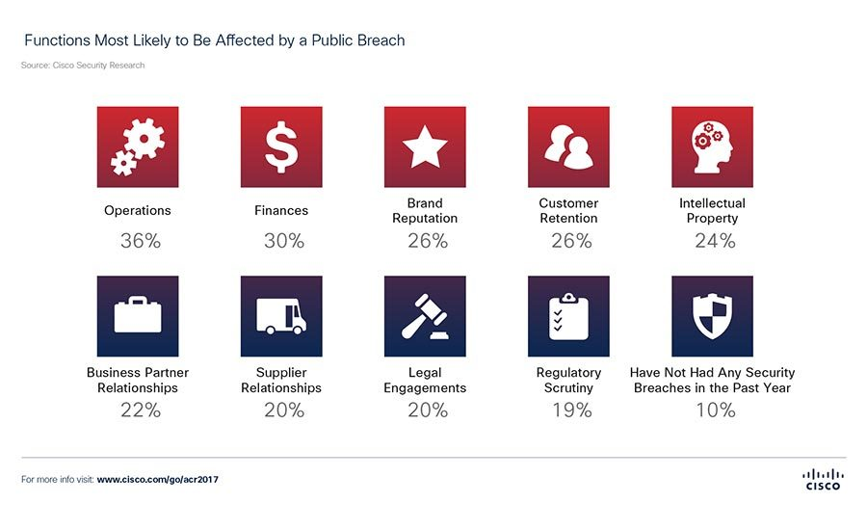

Slide 26
Vulnerabilities
4

Slide 27
What is a Vulnerability?
A cyber-security term that refers to a flaw in a system that can leave it open to attack.
Vulnerability is the composition of three elements:
A flaw in system.
Access of attacker to that flaw.
Capability of attacker to exploit the flaw.

Slide 28
Classification of Vulnerabilities
Vulnerabilities are classified according to the asset:
Hardware.
Software.
Network.
Personal.
Physical site.
Organizational.

Slide 29
Causes
Some of the vulnerability in the system occur due to:
Missing patches.
Cleartext credentials.
Using unencrypted channels.
RF Emanation.

Slide 30




TEAM PRESENTATION
Yatree Ladani Computer Engineer
Jaivin Gajera Computer Engineer
Prachi Jethwa Computer Engineer
Keyur Chaniyara Computer Engineer

Slide 31
THANKS!

